Slide 1

REPAIRS TO POTABLE STAINLESS STEEL WATER PIPELINE IN THE PIPELINE RACK AT ISLAND VIEW IN THE PORT OF DURBAN
TENDER CLARIFICATION MEETING
06 AUGUST 2026
10H00
Notes:
Growth and Reinvent

Slide 2
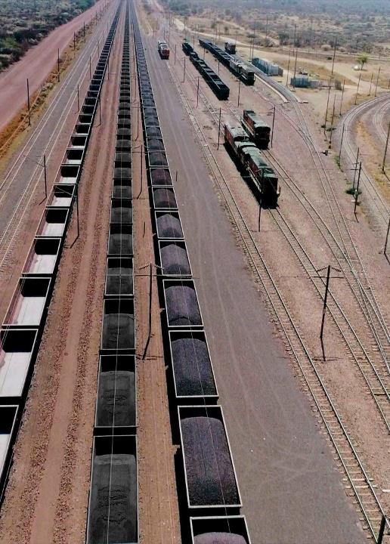
Contents
Agenda
01 | Welcome
02 | Introduction and Agenda
03 | Safety Briefing and Evacuation Procedure
04 | Project Overview
05 | Commercial Presentation
06 | Enterprise Supplier Development
07 | Technical Presentation
08 | Question and Answer
2

Slide 3
Project Background- Siphelele

Slide 4
PROJECT BACKGROUND
The works that the Contractor is to perform involve repairs to a stainless-steel potable water pipeline located on the pipe rack at different elevations within the Island View Precinct, Port of Durban, with work required at heights of up to 6.5 m above ground level. The pipeline is currently operational and exhibits leakage at the seam welds across multiple joints.
The stainless-steel potable water pipeline varies in size, with nominal diameters of 150 mm and 200 mm at different sections along the network extending from Berth 1 to Berth 10. The primary purpose of this document is to outline the scope of services and deliverables that Transnet National Ports Authority (TNPA) will require of a Principal Contractor with the necessary experience and expertise to conduct repairs and rewelding to a stainless-steel water pipe on the pipe rack.

Slide 5
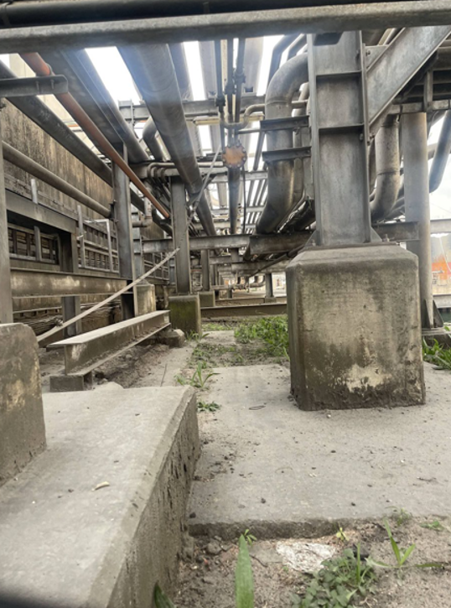
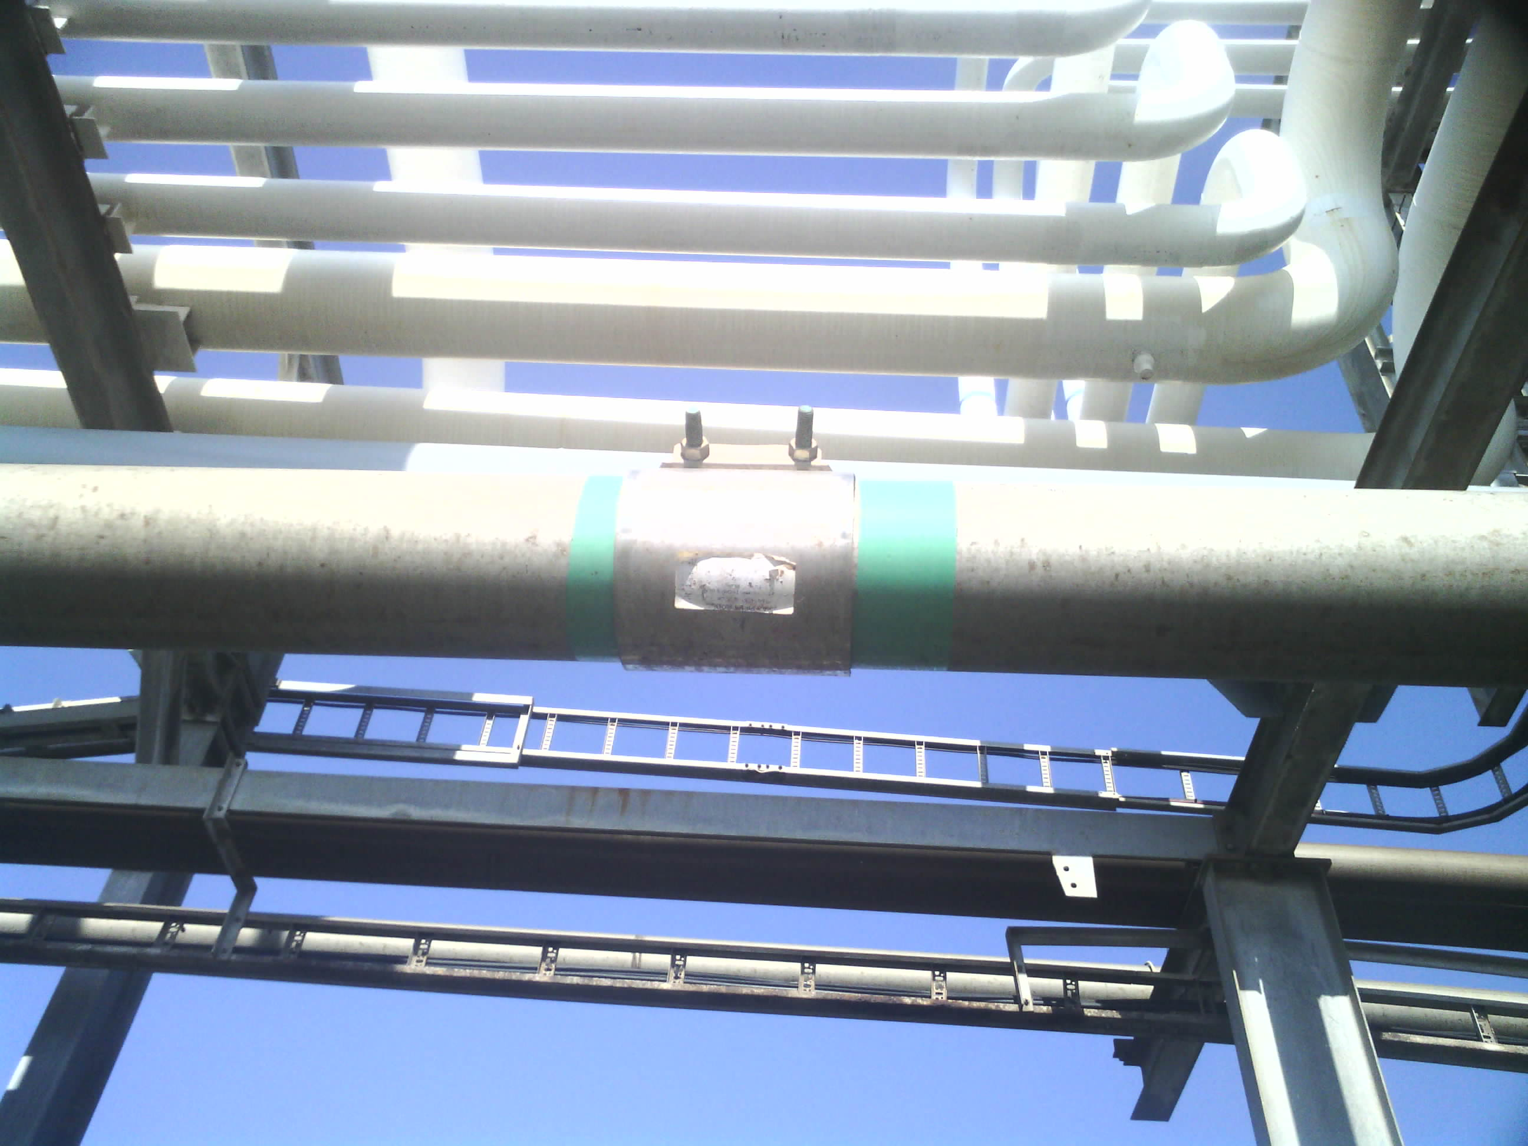
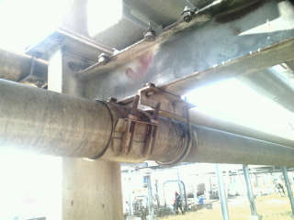
EXISTING PIPELINE CONDITIONS
Pipe Rack Overview
Leaking Welds with Cascade Clamps
All temporary cascade clamps at leaking locations shall be removed before permanent welding repairs commence. All removed cascade clamps shall be returned to TNPA upon completion of the works.

Slide 6
Commercial- Hlengiwe

Slide 7
COMMERCIAL REQUIREMENTS
PLEASE GO TO NATIONAL TREASURY eTENDER PUBLICATION PORTAL AT www.etenders.gov.za and the Transnet website at https://transnetetenders.azurewebsites.net TO DOWNLOAD ALL PDF’S
CLARIFICATION REGISTERS
ADDENDUMS

Slide 8
TENDERING PROCEDURES
All communications whether general, commercial or technical to go via the Procurement
Department, HLENGIWE DLAMINI in writing.
Email – TNPAtenderenquiriesdbn@transnet.net
All communication will be sent via a clarification register and will be e-mailed to all attendees of this clarification meeting and posted on the Transnet Portal and NT.
Please complete the attendance register and ensure that the contact details are correctly recorded (as these contact details will be used to issue all clarifications and addendums).
Last day for Clarification – Five working days before the closing date (11 August 2026, 16:00).
Electronic Tenders Documents must be legible.

Slide 9
TENDERING PROCEDURES (Continued)
TENDERING PROCEDURES
Tender closing date: 18 August 2026 at 14h00 via the new electronic tender submission system, the e-Tender Submission Portal
“HOW TO” GUIDE FOR BIDDERS IS INCLUDED IN THE TENDER (ALLOW TIME)
NO EXTENSIONS TO THIS DATE WILL BE ENTERTAINED
NO LATE TENDERS WILL BE CONSIDERED

Slide 10
TENDERING PROCEDURES (Eligibility Criteria)
Stage 1A – Administrative and Substantive Responsiveness
Whether the Bid has been lodged on time
Whether all Returnable Documents and/or schedules [where applicable] were completed and returned by the closing date and time
Verify the validity of all returnable documents
Verify if the Bid document has been duly signed by the authorised respondent
Whether any general and legislation qualification criteria set by Transnet, have been met
Whether the Bid contains a priced offer. Respondents are required to complete the BOQ in full, failure to complete may result in disqualification.
Whether the Form of Offer & Acceptance is completed in full and signed.
Whether the Bid materially complies with the scope and/or specification given
Stage 1B Eligibility with regards to attendance at the clarification meeting:
Ensure your Clarification Meeting Returnable is signed today and returned with your tender.

Slide 11
TENDERING PROCEDURES (Eligibility Criteria)
Stage 1B – CIDB Registration 3ME or higher class of construction work
Account to be “Active”
Stage 1B – Technical Pre-Qualification criteria:
Tenderer to submit certificates of the key personnel as per the role descriptions in the organizational chart for Construction work.
Valid trade certificate and proof of registration with the Plumbing Industry registration board (PIRB The Tenderer must submit a valid trade test certificate and proof of registration with the Plumbing Industry registration board (PIRB). The plumber must be authorised to issue Certificates of Compliance (COC).
Tenderer to submit a valid proof of registration with South African Council for the Project and Construction Management Professions (SACPCMP) for the Safety officer to be appointed to the project.
Tenderer to submit proof of welding trade test certificate for the personal that will be conducting welding activities on this project

Slide 12
TENDERING PROCEDURES (Eligibility Criteria Continued)
The tenderer is required to submit all documents as stated in C.2.23 of the tender data and the
tender offer will only be accepted if the tenderer complies with C3.13 of the tender data such as:
A valid Tax Clearance Certificate issued by the South African Revenue Services. Tenderers also to provide Transnet with a TCS PIN to verify Tenderers compliance status.
A valid B-BBEE Certificate from a Verification Agency accredited by the South African Accreditation System [SANAS], CIPC B-BBEE Certificate or a Sworn Affidavit confirming annual turnover and level of black ownership in case of all EMEs and QSEs with 51% black ownership or more together with the tender;
A valid CIDB certificate in the correct designated grading;
Proof of registration on the Central Supplier Database
Letter of Good Standing with the Workmen’s compensation fund by the tendering entity or separate Letters of Good Standing from all members of a newly constituted JV.

Slide 13
CONTRACT DATA
NEC 3 ECC
Main Option B – Priced contract with price list
Secondary Clauses
  X2: Changes in the law
  X7: Delay damages @ R1 500.00 per day
  X18: Limitation of liability
  Z: Additional conditions of contract

Slide 14
Enterprise & Supplier Development- (Specific Goals)

Slide 15
TRANSNET PREFERENTIAL PROCUREMENT POLICY SPECIFIC GOALS
The following preference points must be awarded to a bidder who provides the relevant required evidence for claiming points:
The following specific goals will apply for this transaction:
Specific Goals | Number of points (80/20 system) | Number of points (90/10 system)
B-BBEE Status Level of Contributor 1 or 2 | 04 | 02
30% Black Women Owned Entities | 06 | 03
EME or QSE 51% Black Owned | 10 | 05
Non-Compliant and/or B-BBEE Level 3-8 contributors | 00 | 00

Slide 16
EVIDENCE REQUIRED FOR CLAIMING SPECIFIC GOALS
In terms of Transnet Preferential Procurement Policy (TPPP) and Procurement Manuals, preference points must be awarded to a bidder for providing evidence in accordance with the table below:
Specific Goals | Acceptable Evidence
B-BBEE Status Level of Contributor (1 or 2) | B-BBEE Certificate / Sworn - Affidavit / CIPC B-BBEE Certificate (in case of JV, a consolidated scorecard will be accepted) as per DTIC guidelines
30% Black Women Owned Entities | Certified copy of ID Documents of the Owners
EME or QSE 51% Black Owned | Audited Annual Financial Statements B-BBEE Certificate / Sworn - Affidavit / CIPC B-BBEE Certificate (in case of JV, a consolidated scorecard will be accepted) as per DTIC guidelines
Note: Tenderers who fail to submit acceptable evidence for specific goals applicable in will be allocated zero (0) preference points.

Slide 17
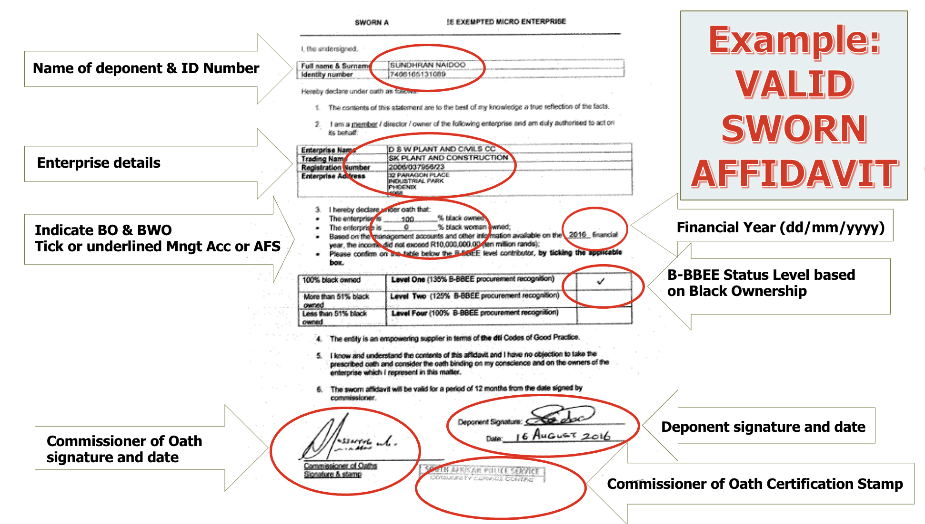
VALID B-BBEE SWORN AFFIDAVIT

Slide 18
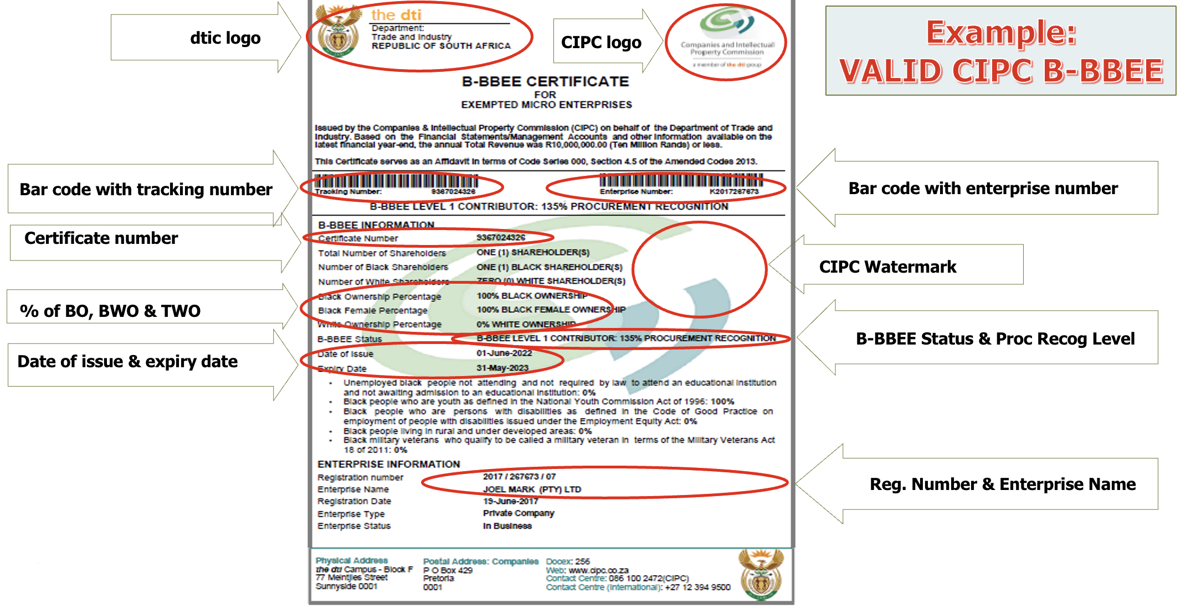
VALID CIPC B-BBEE CERTIFICATE

Slide 19
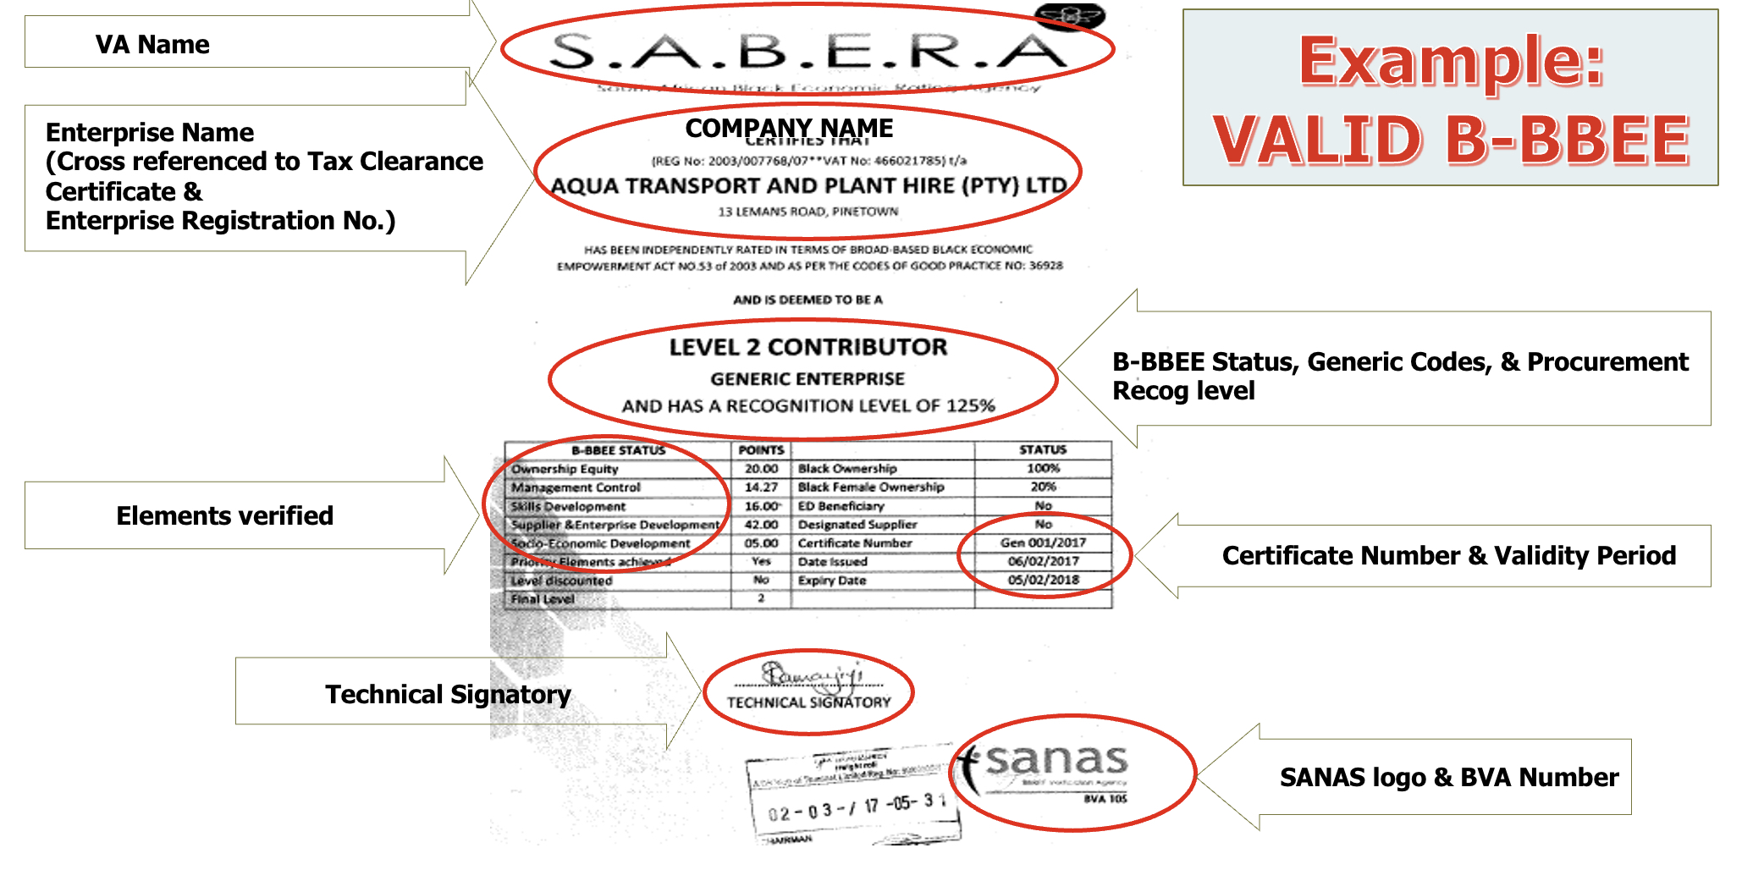
VALID B-BBEE CERTIFICATE

Slide 20
Technical Presentation – Siphelele

Slide 21
SCOPE OF WORK
NB: The contractor shall allow in his prices for the following:
The potable water pipeline is in use and operational and within the Island View precinct, hence all Island View precinct protocol must be always adhered to as this is a National Key Point.
The Contractor shall allow for working under these conditions and exercise due care to avoid property damage. Access to site will be via the existing service roads within the Port. The prospective tenderers shall exercise due diligence during the execution of the project to minimize risk of damaging existing equipment and infrastructure and ensure minimal disruption in the Port of Durban operations.
The Contractor will be responsible for any costs associated with damages to existing infrastructure located on the site; the Contractor shall therefore make provision in his prices for the risk of damage to existing equipment and infrastructure.
The contractor should also make provision for standing time as hot work is not allowed on the berth when a vessel is at the berth.

Slide 22
SCOPE OF WORK
Hot Work Requirements:
All hot work shall be carried out under a valid Hot Work Permit and in compliance with the following minimum requirements:
A dedicated Fire Watch must be present for the full duration of hot work.
Protective Barrier / Cocoon:
Supply and install a heat-resistant, non-flammable cocoon around the pipe section being welded.
Minimum thickness: 10 mm. Coverage: Extending to at least 500 mm beyond the weld area.
Installation: Secure fastening to prevent displacement during work.
Ventilation: Ensure adequate ventilation to prevent gas accumulation.
Monitoring: Use intrinsically safe gas detectors to ensure a safe atmosphere.
All hot work areas must have continuous monitoring for flammable vapors using intrinsically safe gas detectors.
Adequate firefighting equipment (minimum: portable extinguishers; hose reels and foam units if required) must be on site and positioned within accessible distance before commencement of hot work.

Slide 23
SCOPE OF WORK-continued
Potable waterpipe repairs:
Temporarily shut off the water supply in the section or berth working on to ensure a safe and controlled welding process.
Tenderer shall remove covering from damaged pipe and return it to TNPA, back grind welded seam to root, ensuring surface preparation meets SANS requirements.
Fill root weld with Tungsten Inert Gas (TIG) Welding, adhering to SANS welding procedures
Back grind entire capping weld 2mm to 3 mm deep, maintaining surface finish
Recap the entire diameter with TIG Welding.
Test welds with Liquid Penetrant Inspection (LPI), verifying weld integrity and detecting potential defects.
Fabricate sleeve in two halves to fit around pipe diameter (200mm wide, centered on weld with 100mm extension each way), following structural steel work guidelines. This thickness should be same as the thickness of the pipe.
Weld sleeve onto pipe, covering seam using TIG welding.

Slide 24
SCOPE OF WORK-continued
Final Inspection:
Test fillet weld on sleeve to pipe using LPI, ensuring weld quality and integrity.
Material Specifications:
Pipe material: Stainless steel
Steel grade: 316L
Chemical composition (W.T.): C ≤ 0.035, Mn ≤ 2.00, Si ≤ 1.00, S ≤ 0.030, P ≤ 0.045, Cr 16.0 – 18.0, Ni 10.0-14.0 and Mo 2.0 -3.0.

Slide 25
SCOPE OF WORK-continued
Stainless Steel Band:
Tenderer shall install stainless steel band (SS 316L or equivalent) over welds, ensuring:
Band width: 300mm
Band thickness should be same as the thickness of the pipe
Secure band to pipe using TIG welding, ensuring continuous welding along the band edges.
The band must be tightly fitted to pipe surface, and the band thickness must be the same as the thickness of the pipe

Slide 26
SCOPE OF WORK-Continued
Ball Valves:
Tenderer shall be responsible for the supply, delivery, and installation of stainless steel 80mm ball stop valves with matching flanges to be installed in-line between existing pipeline sections. The scope includes supplying full-bore 80mm stainless steel ball stop valves (Grade 316 or equivalent) with PN16-rated flanges, lockable lever or gear-operated handles, and compliance with ISO 5211 and applicable SANS. All necessary accessories including flange kits, gaskets, bolts, nuts, and washers suitable for use in corrosive or marine environments must be provided. Installation involves isolating and fitting the valves between the pipeline segments using flanged connections, ensuring proper alignment, sealing, and torque tightening to manufacturer specifications. Valves must be adequately supported and installed in accordance with OEM guidelines, SANS 1200, and TNPA mechanical and piping standards

Slide 27
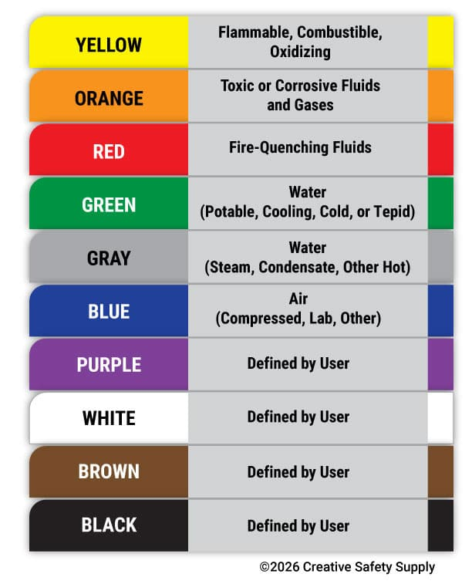
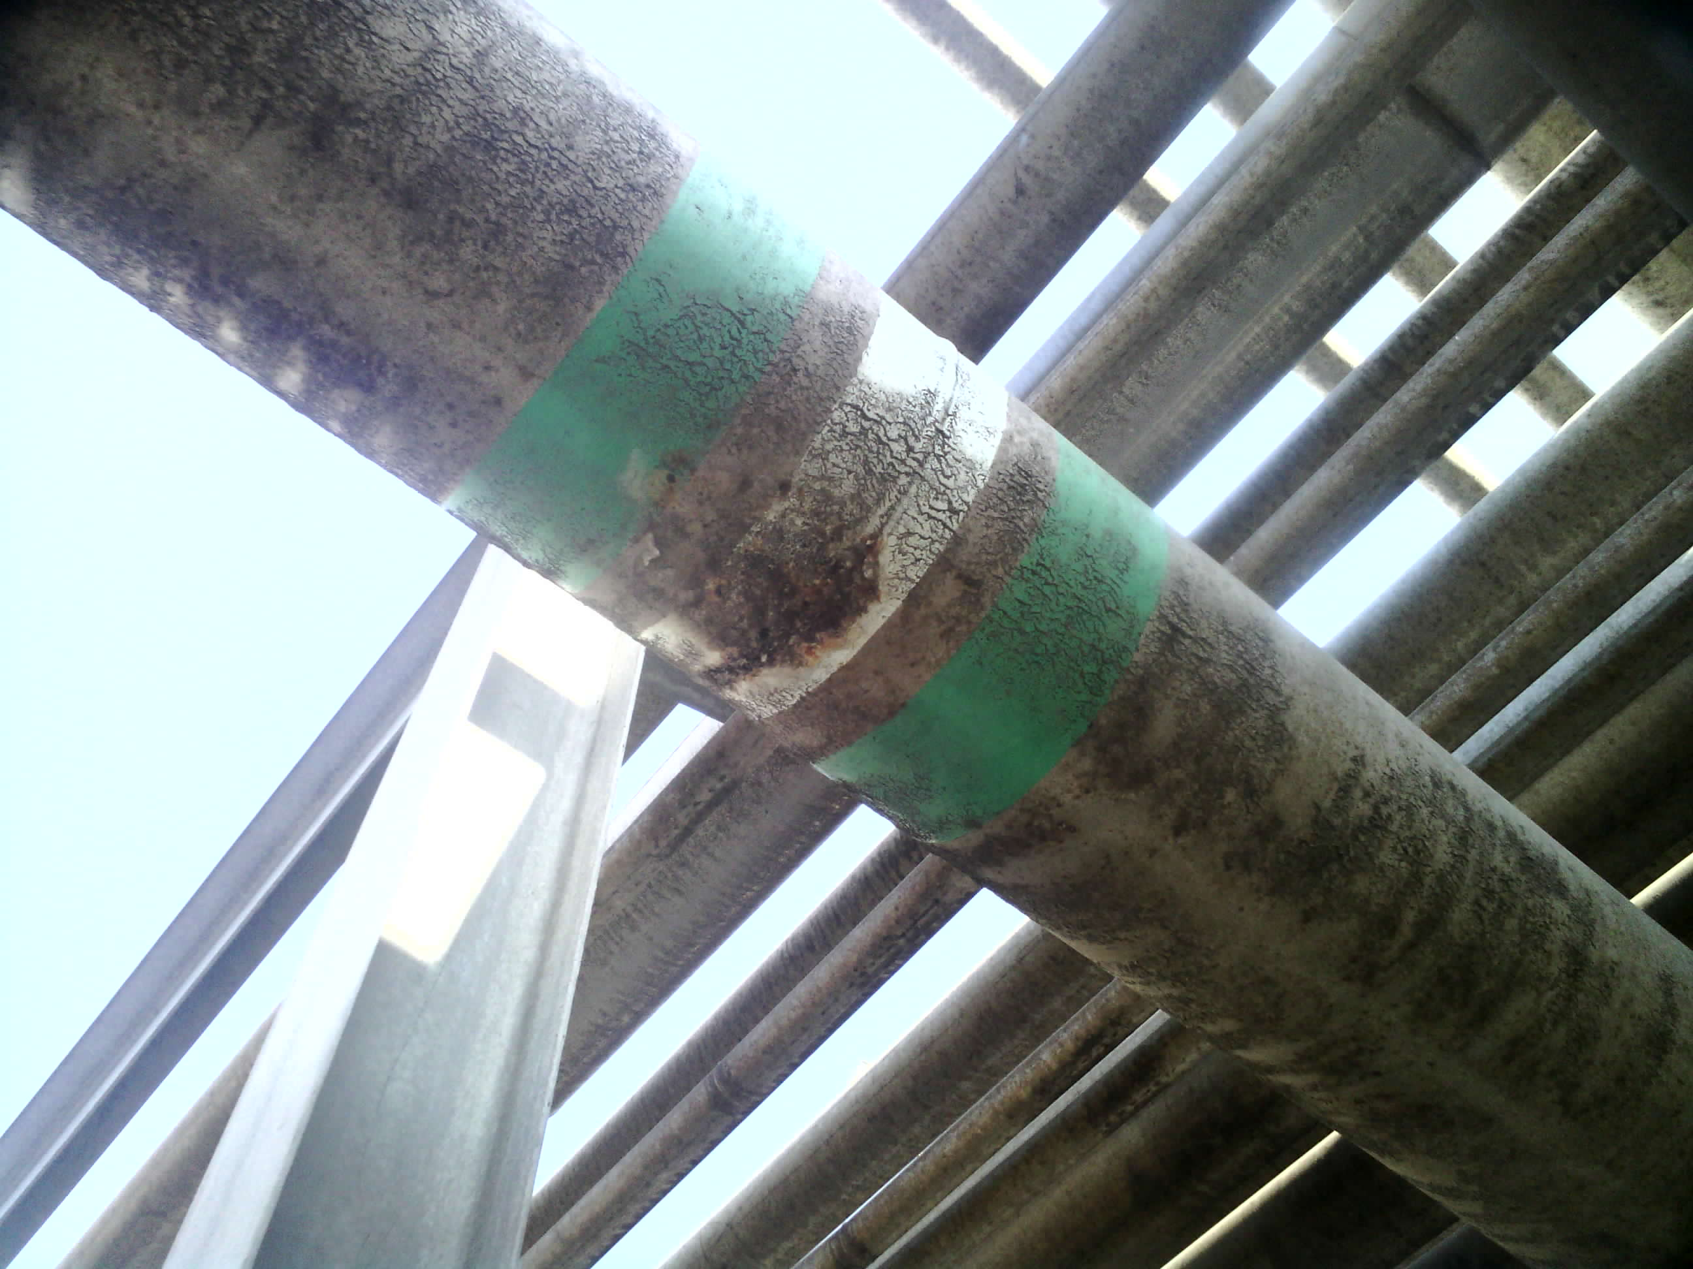
SCOPE OF WORK-Continued
Stainless Steel Air Bellows:
The Service provider will be required to supply and install flexible, corrugated stainless steel air bellows with flanged ends. Ensure the air bellows are PN 16 pressure rating
Colour Coded Bands:
Supply and apply green color coding to stainless steel
pipe at 12m intervals to distinguish from pipes in the rack.
Apply durable, weather resistant green tape for colour coding

Slide 28
SCOPE OF WORK-Continued
Quality:
  Data Pack
  The data pack shall consist of marked up as-built drawings, ISO’s showing welder references, NDT reports, calibrations certificates for gauges, material certificates, punch lists, etc.
  Quality Procedures
  A detailed quality plan is to be submitted before any work may commence, for approval of hold, witness, and inspection, points. The quality plan shall be tailored to comply with the client’s specific requirements.
  All work shall be performed by a qualified and coded welder, certified to relevant SANS standards.
  Welding procedures and qualifications shall comply with SANS 10047.
  Material and consumables shall meet relevant SANS Specifications

Slide 29
SCOPE OF WORK-Continued
Safe equipment for working at height:
  A contractor to supply safe and suitable working-at-height equipment for every height work. A contractor must appoint a competent person in writing who must ensure all height equipment operations are carried out under his or her supervision and that all erectors, team leaders and inspectors are competent to carry out work..

Slide 30
SCOPE OF WORK-Continued
Waste collection and Disposal:
  The collection and disposal of all the rubble/ waste on site should only be done by contractor or subcontractor with waste disposal license issued by Transnet National Ports Authority, Port of Durban.

Slide 31
Thank you

